Slide 1
Thermal test workshop
Proposed agenda/talking points
8 February 2022

Slide 2
Main agenda/talking point areas
Background
Suspension system
Thermocouples
Cover plates/dummy solar panels
Heaters (patch panel, control, monitoring)
OBCSW/Teststand support
New TBT/TVCT simulations
Sequence of events: assembly sequence, location
Various items.

Slide 3
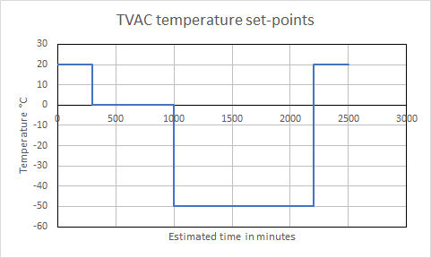
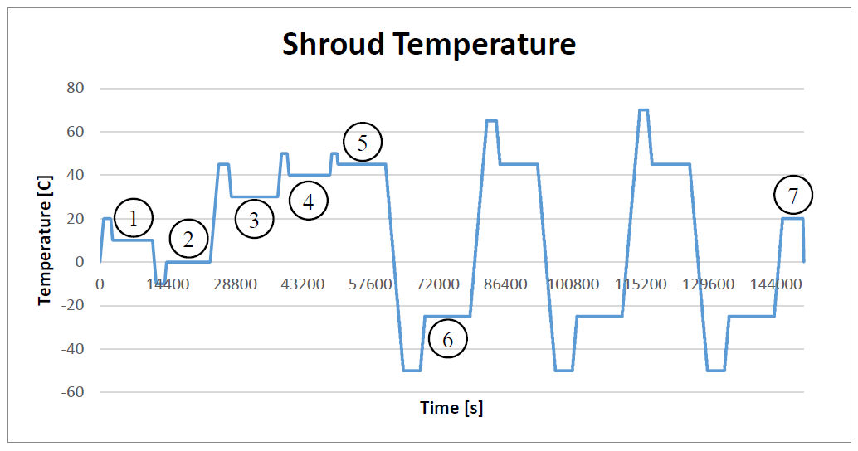
Thermal Balance Test
Thermal Vacuum Cycling Test

Slide 4
1 – Background
Thermal Vacuum Cycling (TVCT) test is ”mandatory” – it shows that the satellite can ”survive” the space environment.
The Thermal Balance Test (TBT) is a ”bonus” since we are running the TVCT, but puts higher requirements on support than the TBT. Its purpose is to check the accuracy of the mathematical model.

Slide 5
2 – Suspension system
Parts:
All material parts available.
I think we have the correct epoxy and tool. I will check.
Jens Freiberg, machinist at TR 31, prepares the parts.
I have given him the dummy hinges.
I have bought the M2.5 screws and nuts for the dummy hinges. Allen (hex) head (insex)!
Assembly/Mounting:
Mostly trivial (?) except the wires (how to make them the same length?) and the PEEK inserts in the dummy hinges.
We have the correct epoxy. Help from OHB to apply?
We should practice hanging a 3 kg mass and hook it up to the TVAC. Also see how umbilical runs.

Slide 6
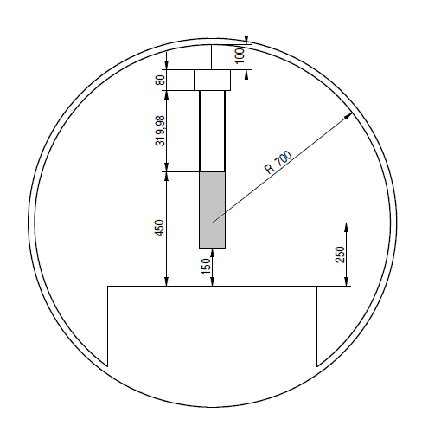
Is this correct?
Deployable solar panels
Umbilical connector
The meeting concluded that this is correct!
Figure 2 Location in TVAC of the satellite.

Slide 7
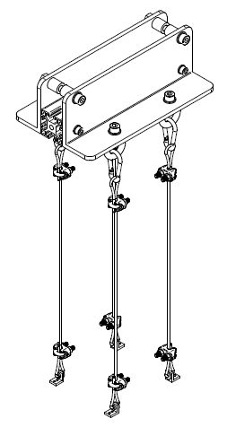
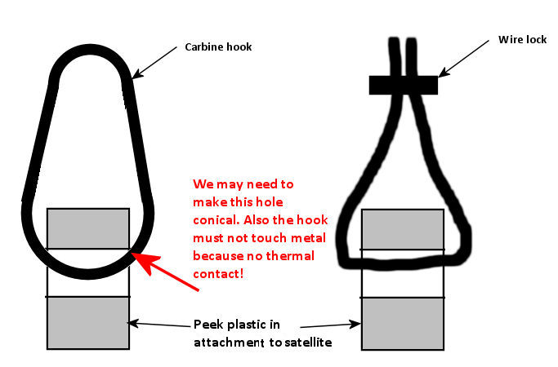
We need to take a look at this again. Please check drawing that comes next.
Wire loop
The wire length depends on where these are clamped to the wire loop…

Slide 8
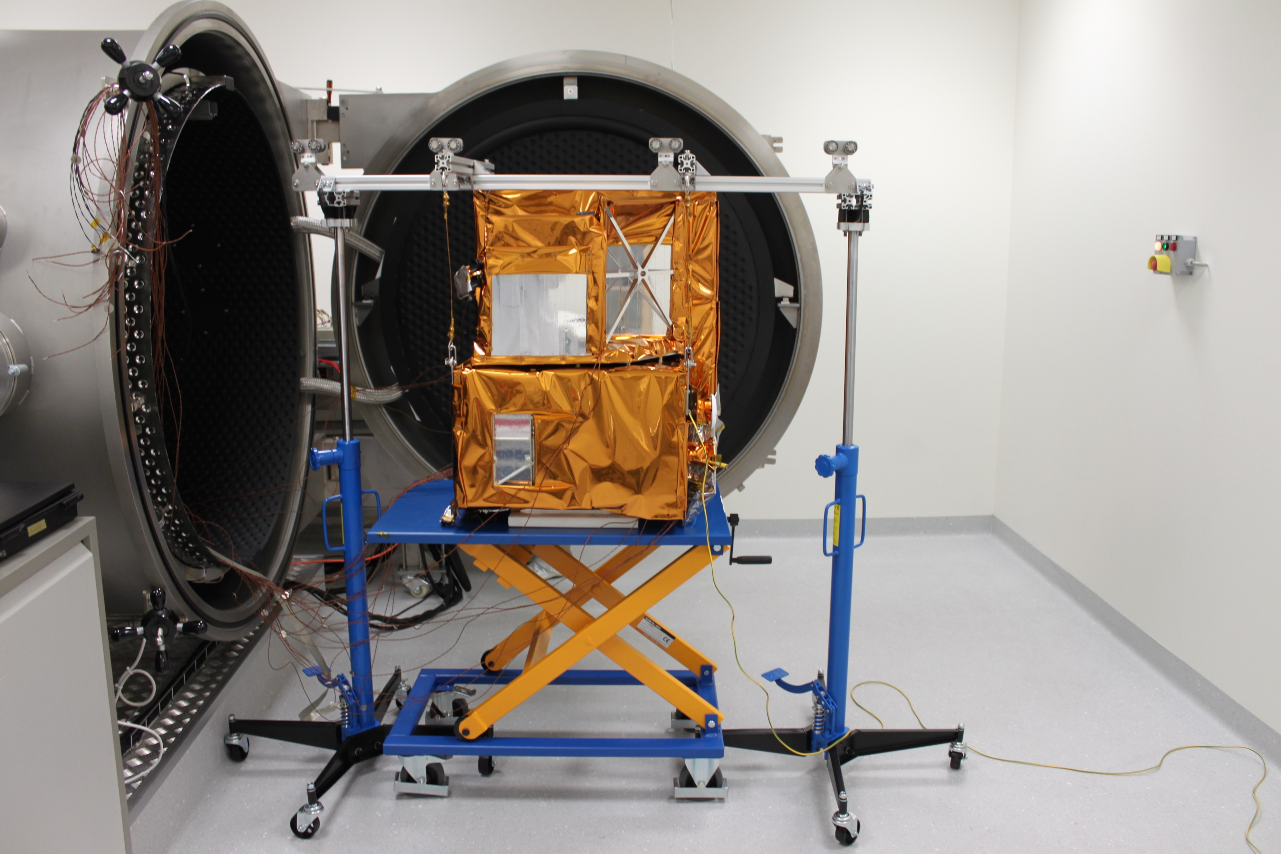
How do we do this?

Slide 9
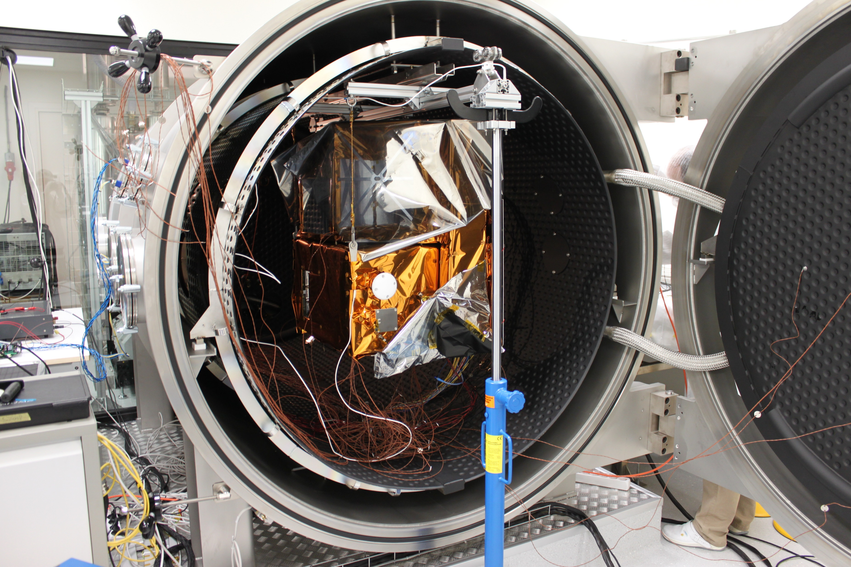

Slide 10
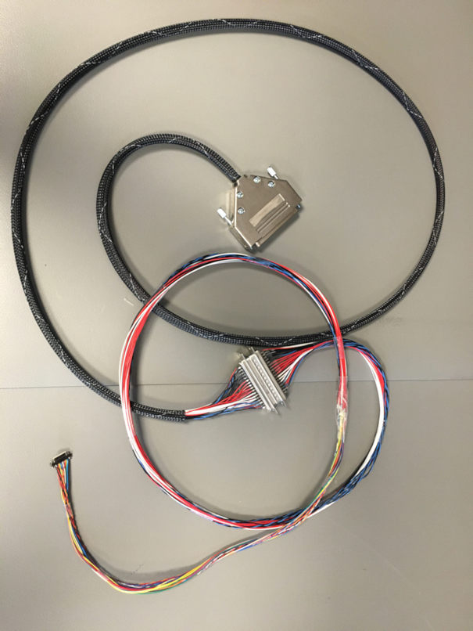

Slide 11
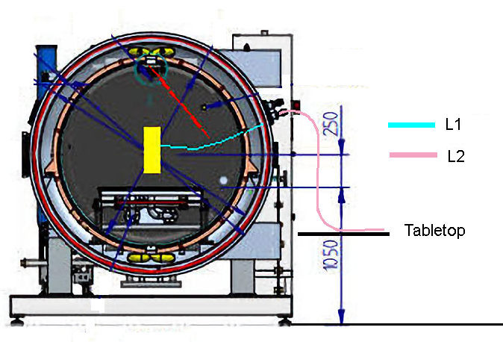

Slide 12
3 – Thermocouples
The kapton and copper tape is in the glass cabinet in my office. There are three thermocouples there also for you to use for attachment test. You may need a sharp scissor to cut the tape and a scalpel to maeuver the tape pieces. Ther is a scalpel in the tool case on wheels in the integration lab.I can buy a good scissor and a new scalpel over the weekend, if you wish. I can also pick up the TC readout instrument from max.
Mech team: Just let me know when you plan to do this work and I can have the stuff ready for you.
Location:
Have we located the location of the nodes in Filipp’s document? YES! See next slide
Are they separated enough to be possible to mount? Probably.
Which surfaces are conducting? Check actual hardware.
Attachment/removal test
Taping (Max has ordered Al foil, 6 w delivery, try with copper tape).
Routing cables relative to solar panels/cover plates..
Checking that the TC works (use meter that Max has)?
Can the TCs be removed without disassembling the solar panels?

Slide 13
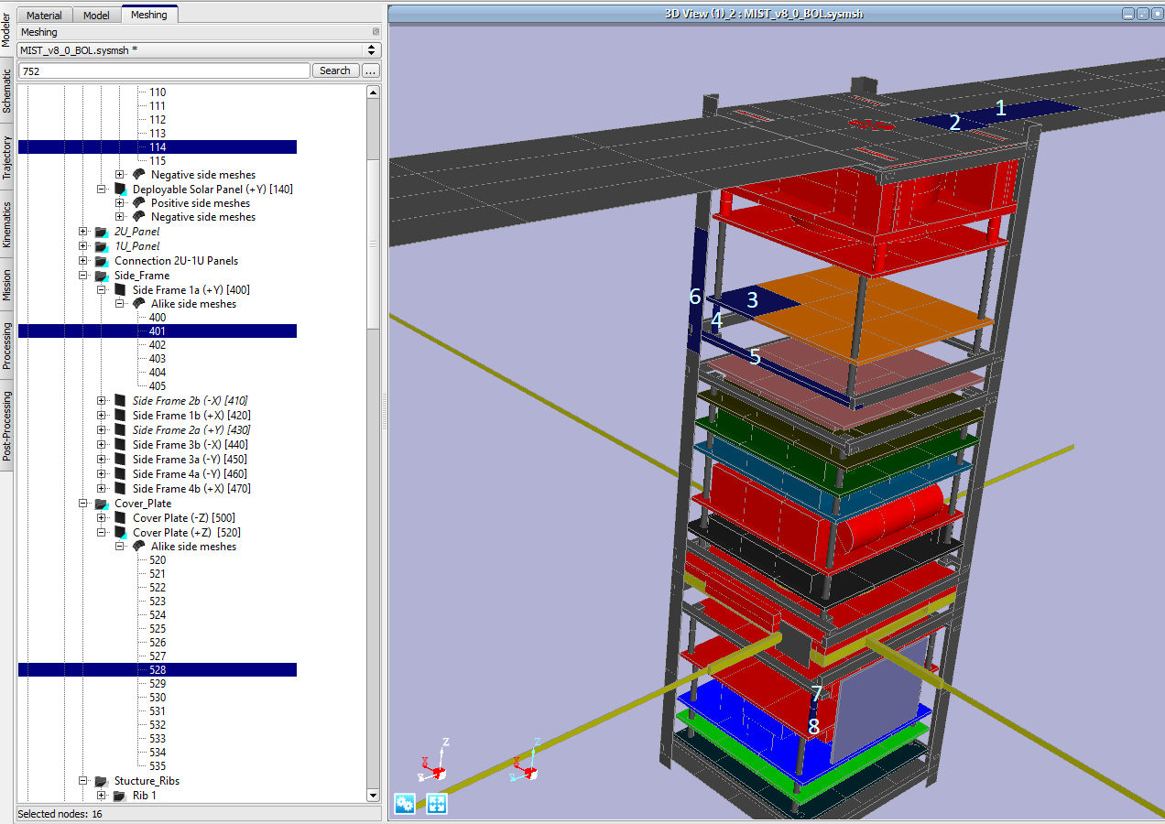
During the meeting we discussed that the TC location should be near the center of the mesh element center. This is more easily understood for nodes 1,2, and 3 in the figure.

Slide 14
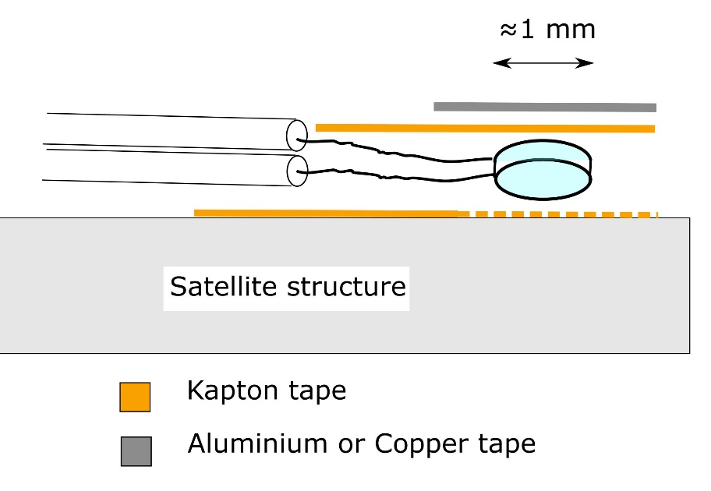
No tape needed if anodized surface
During the meeting we sort of concluded that all TCs should be attached with Kapton tape under the TC.

Slide 15
4 – Cover plates/dummy solar panels
Anodizing dummy and flight cover plates: depends on Kaibins sims of different α/ε
Anodizing dummy solar panels: To be done when TC attachment tests reveral if we need to make cut-outs in dummy solar panels and dummy cover plates.

Slide 16
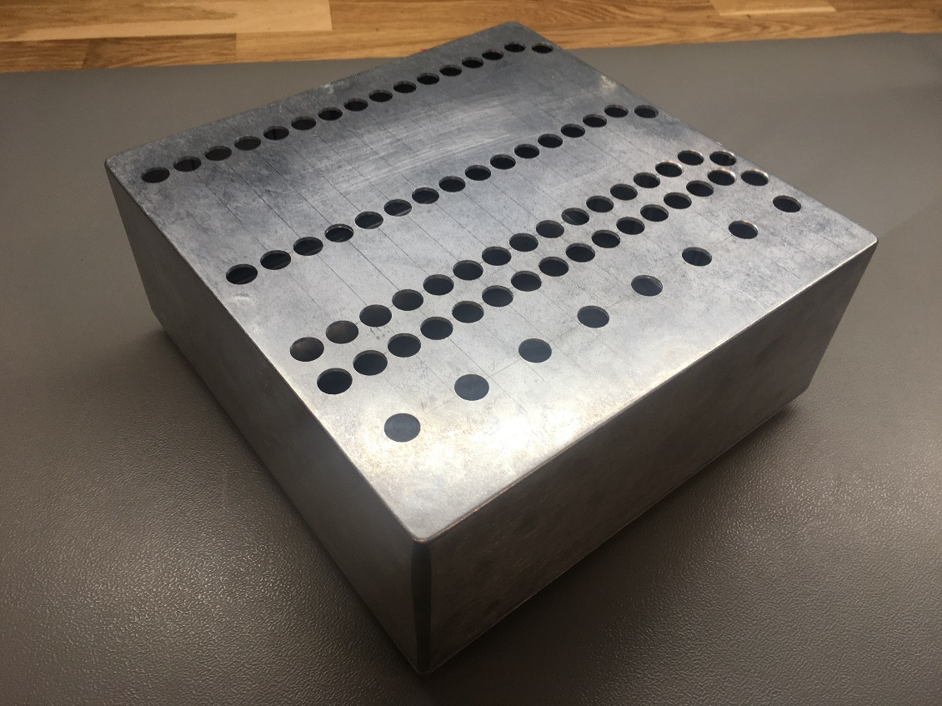
5 – Heaters
Location: See next slide
Patch panel. Status.
Control: Manual.
When to attach heaters in work flow?
Monitoring to prevent heaters to overheat:
Use TVAC measurement system
How many TCs?
Location of TCs?
When to attach TCs in work flow (when heaters are mounted?)?
NanoProp heaters – still to be investigated.
After the meeting I proposed that we put a single ”warning TC” on each of the two ±Z cover plates midway between the two heaters. For the mid-stack heaters we need one TC per heater, becasue the four heaters are on different faces of the satellite. See next slide.

Slide 17
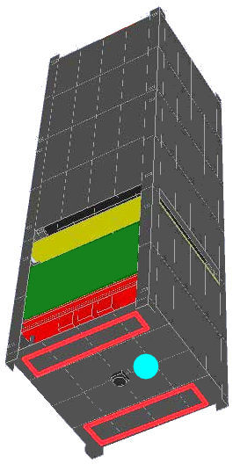
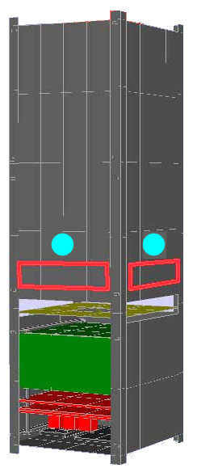
Heater locations and proposed warning TCs attachment

Slide 18
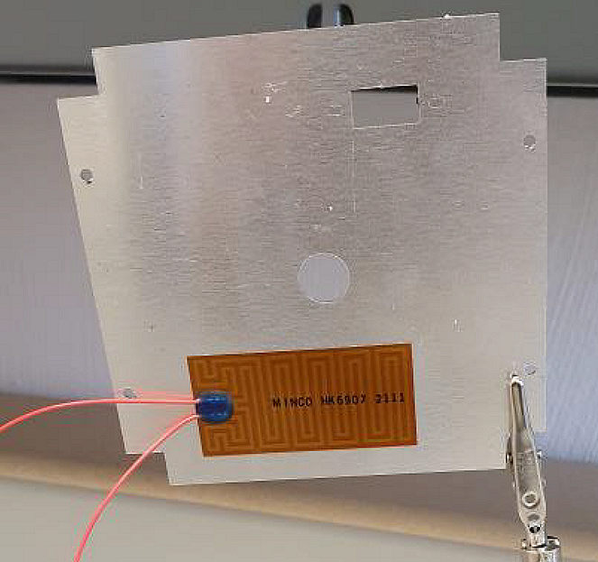

Slide 19
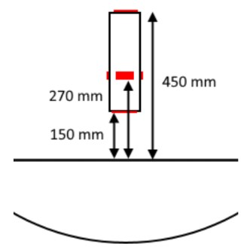

Slide 20
6 – OBCSW/Teststand support
Send commands
Turn off/on equipment or S/S heaters
Request telemetry
Receive and store telemetry
TBT: temperatures and time.
TVCT: many TM values to determine health of S/S, experiment.
Output stored telemetry in readable format (conversion to engineering units)
Interface to satellite EPS/EGSE TRXVU simulator and umbilical.
Any new OBCSW functions needed?
How will we run all of this? From Elveti?

Slide 21
7 – New TBT/TVCT sims
WHY?
New inputs in terms of dissipations need to be taken into account. Readiness for late changes.
Check that subsystem experiment dissipations are correct. (For example: There shall now be no TRXVU dissipation since we use the TRXVU simulator. )
Output to be used in test procedure to get an approximate time-line (time for temperature to stabilize and at what level..).

Slide 22
8 – Sequence of events
Where to install heaters, TBT thermocouples, safety thermocouples, cover plates, dummy solar panels and in what sequence.
What and how to remove after all thermal tests and in what sequence?
Possible locations for installation:
Integration lab: experiments, subsystems, most dummy solar panels.
AlbaNova: TBT thermocouples, heaters, safety thermocouples, remaining dummy solar panels and cover plates. Attach to suspension device.
Where to configure satellite for next test?
Transport container needs to take post-test configuration into account.

Slide 23
9 – Various items
TBT to be run in manual TVAC mode, TVCT in programmed TVAC mode. ”Someone” needs to learn how to program the TVAC in the WinKRATOS software.

Slide 24
Agnes’ comments
- Slide 11: The plan for the umbilical is to connect it without support, as far as I can remember. If there is a problem it is good to have a plan B.
- Slide 12: "Can the TCs be removed without disassembling the solar panels?" No, but it is not a big deal to remove the panels. The question is if there is additional dissassembly than just the solar panels. That could be an issue.
- Slide 22: Why not do as much of the integration as possible in the MIST lab? It is a tricky to transport the satellite without attached solar panels and run the risk of having to run back and forth between the TVAC and the MIST lab to pick up tools. I would prefer to make the integration at one place and then take the satellite directly to the TVAC to be suspended and connceted to the EGSE etc. (Probably we regardlessly may need aone transport container for the satellite with mock solar panels and one for the flight configuration).
- Other: Maybe we should raise the issue of staffing: Any ideas of how to schedule this? How long shifts? How many persons per shifts? Backup staff available on the phone?

Slide 25
Laura’s notes from the workshop
Suspension device: Think carefully on assembly sequence for the suspension device with the hinges and a solution may be to have a hook at the end → this will help inserting the suspension device first into the TVAC and then attach the satellite after.
Thermocouples: check if they need more disassembly other than the mock-up solar panels, probably not. So probably just one panel needs to be disassembled. If it’s not easy to remove them the wires can be cut to leave the thermocouples inside and then removed when the satellite is further disassembled.
For placement could be useful to have a relative position.
Think if some holes in the mock-up solar panels or cover plates need to be made.
Should Kapton tape be added below every thermocouple (even anodized ones)? Not having it everywhere could add an extra gradient making the results less comparable → if Kapton doesn’t interfere with anodized part, all can have it.
Heaters: Decide when to apply heaters and the corresponding thermocouples → see if it is feasible to do it at the TVAC → think of the work-zone
Safety thermocouples should not be on the heater → decide how close do they need to be to the heater and their placement.
Transportation: Maybe we can borrow Nickolay’s plexiglass boxes.

